Slide 1


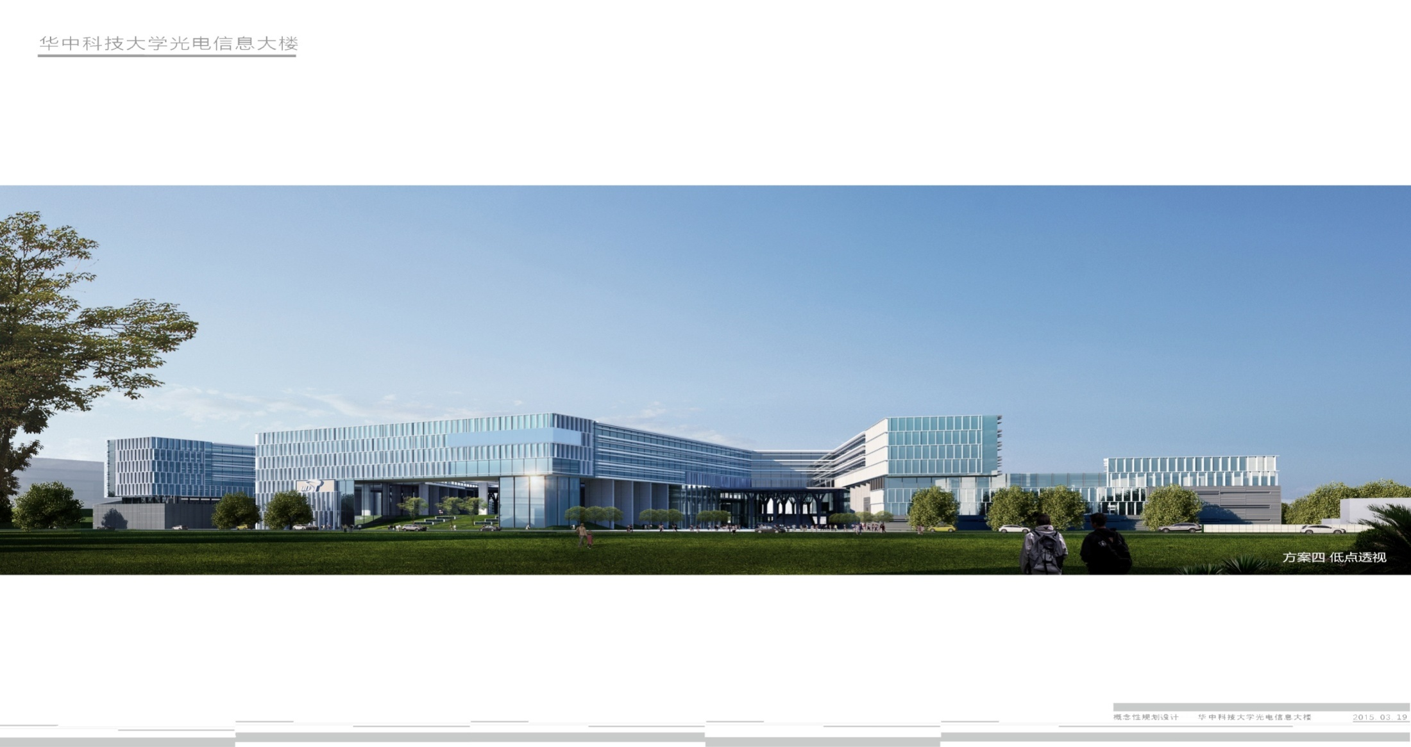
Conclusion for papers(Based on Camers & AI)
Speaker :Ying Jie

Slide 2

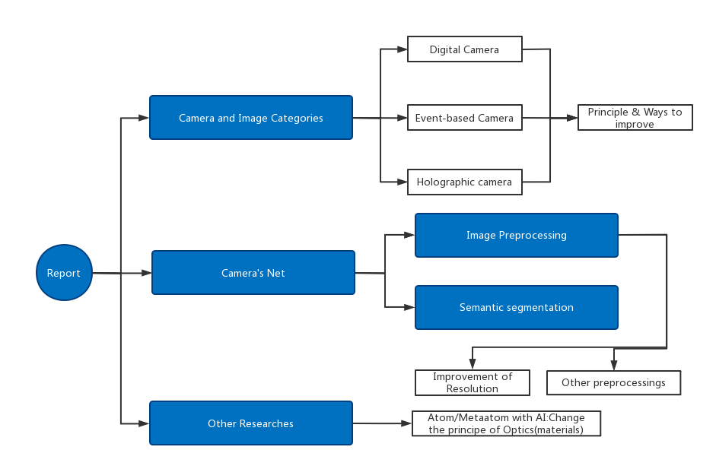
Report Content

Slide 3
Part 1: Introduction of Cameras

Slide 4
Cameras and Image Categories
1. Original Camera
2. Event - Based Camera
3. High Speed Camera
4. Laser Radar

Slide 5
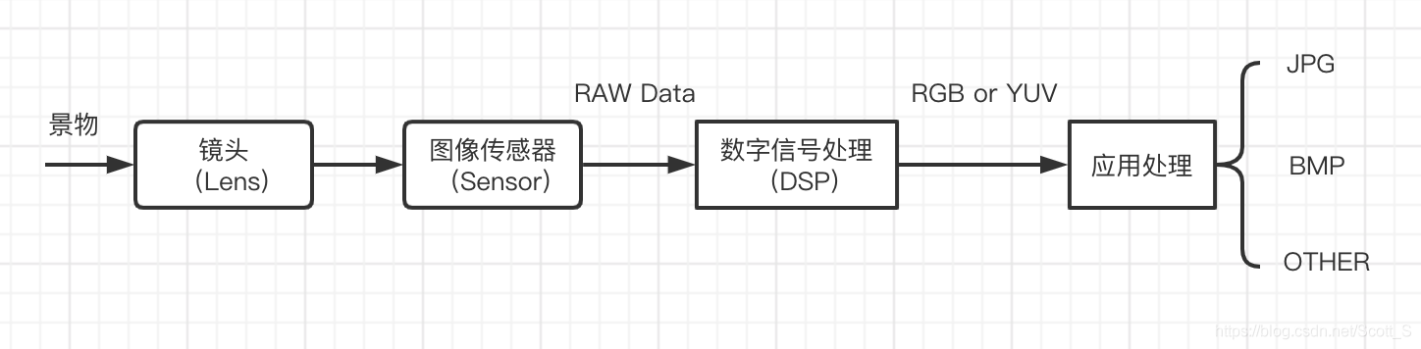
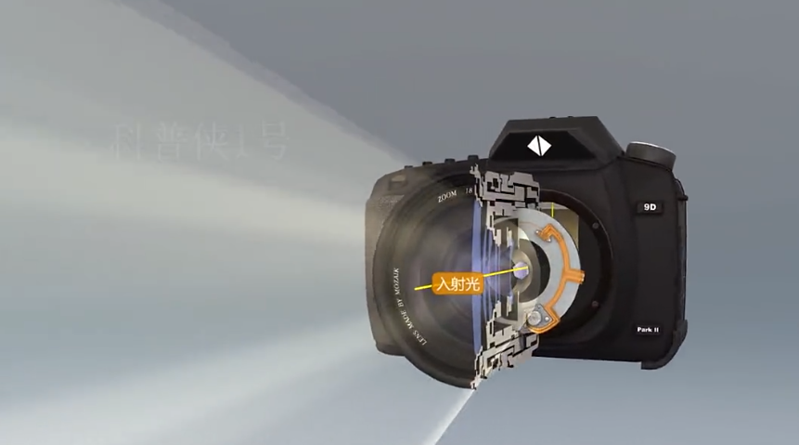
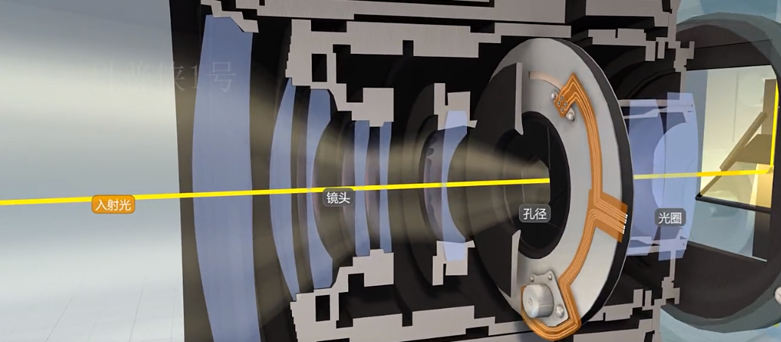
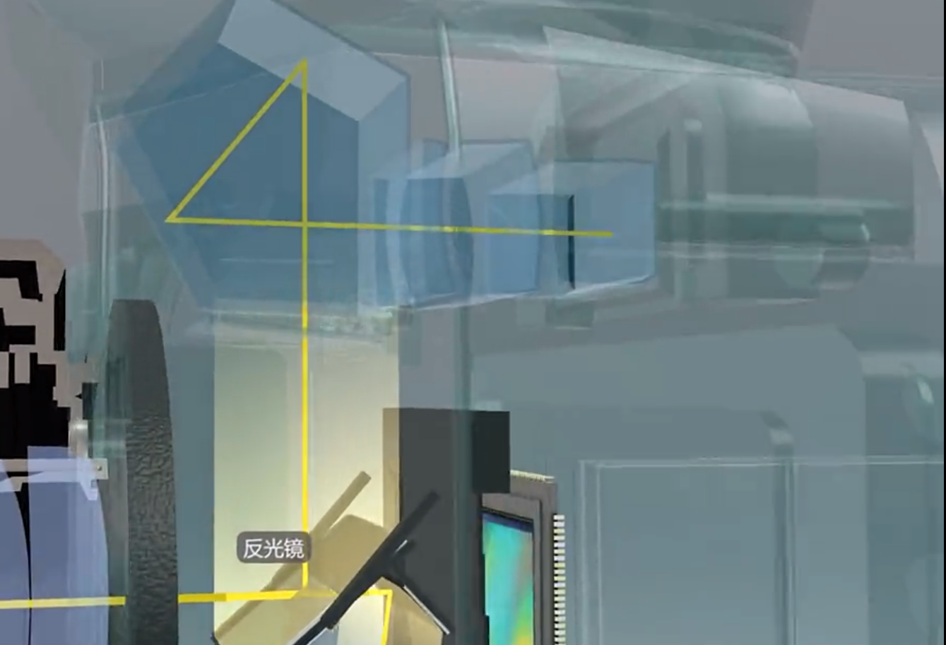
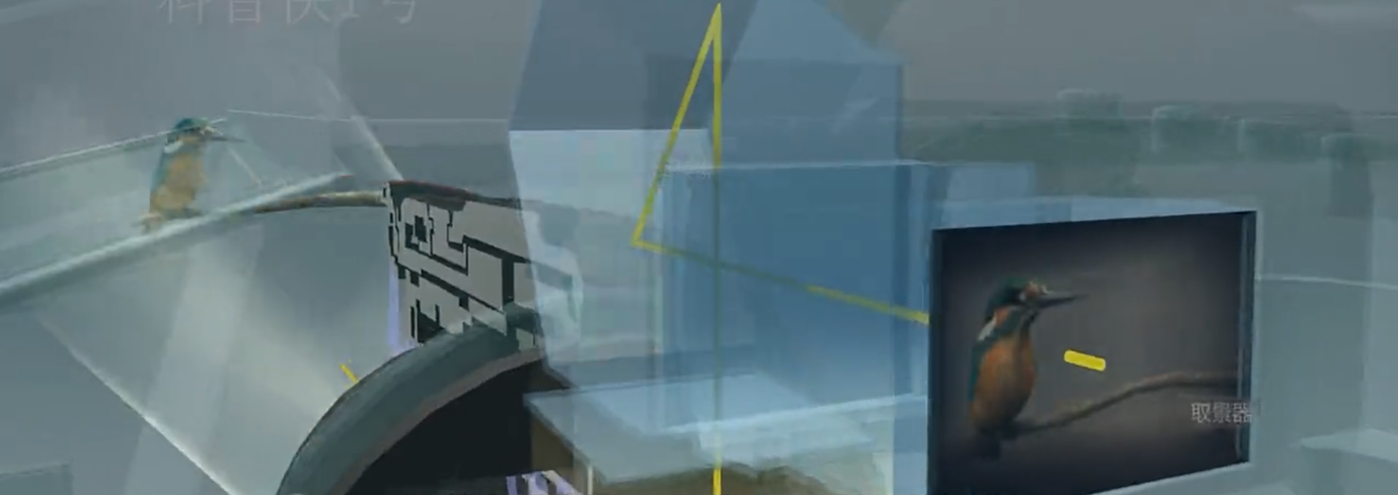
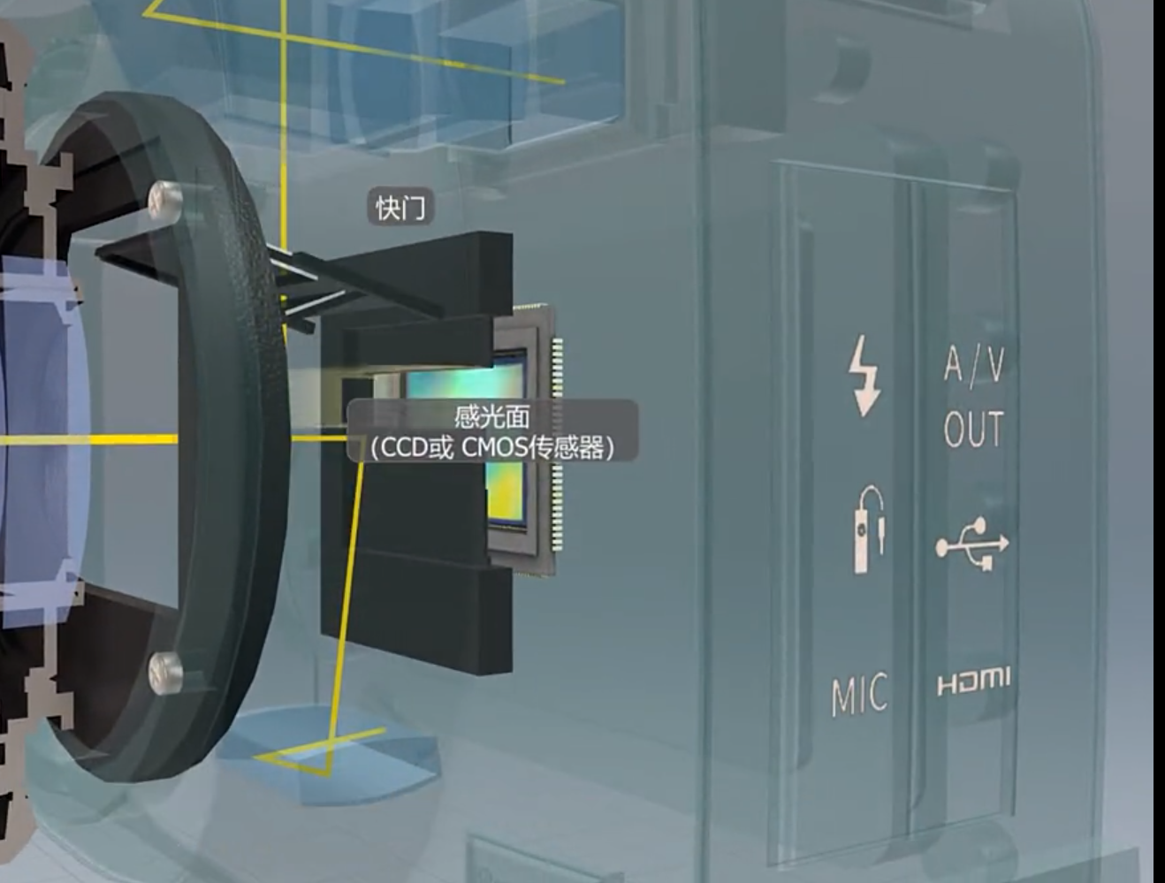
Original Camera（Digital Camera）

Slide 6
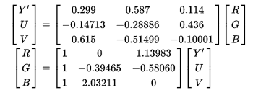
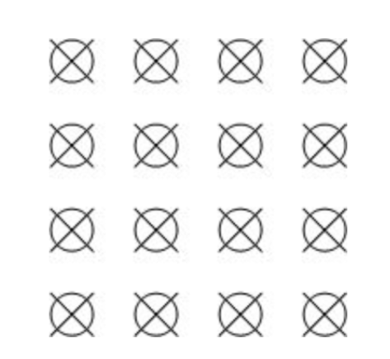
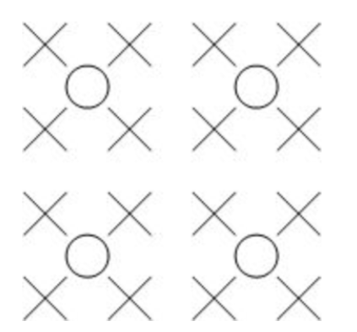
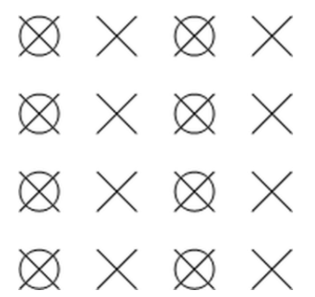
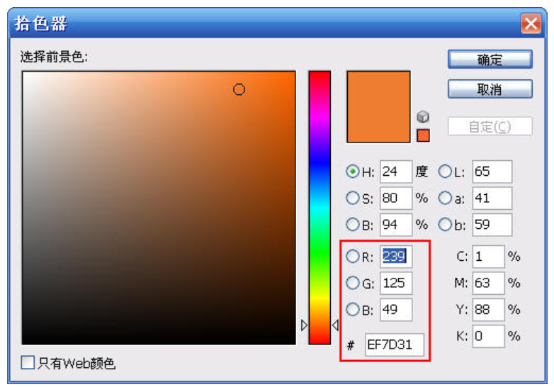
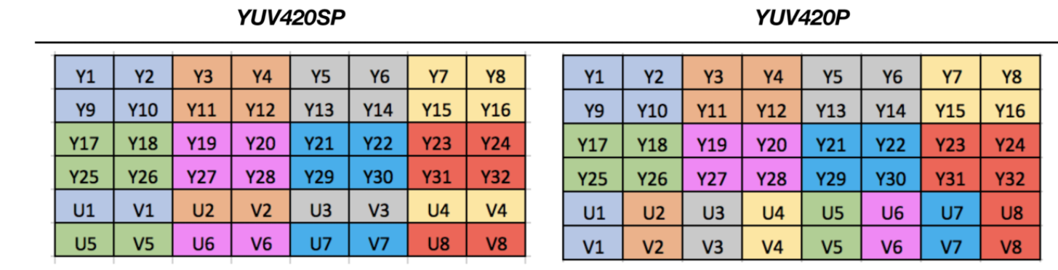
Original Camera（Digital Camera）
Output Inage：
Y：Luma 明亮度，也称灰阶值，以前的黑白电视，是只有Y信号而没有UV信号。
UV：Chroma 色度，色彩及饱和度，用于指定像素的颜色。 “色度”定义了颜色的两个方面——色调(Cr)与饱和度(Cb)
Cr反映了RGB输入信号红色部分与RGB信号亮度值之间的差异
Cb反映的则是RGB输入信号蓝色部分与RGB信号亮度值之间的差异。
RGB Image
YUV Image
YUV 4:4:4 采样
YUV 4:2:2 采样
YUV 4:2:0 采样
Y：Luminance(亮度)，UV：Chrominance(色度),Chroma(浓度)

Slide 7
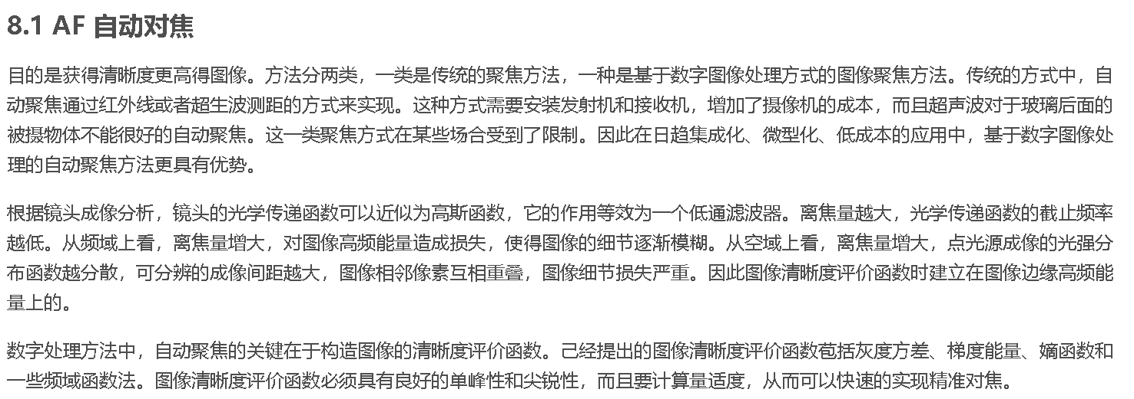
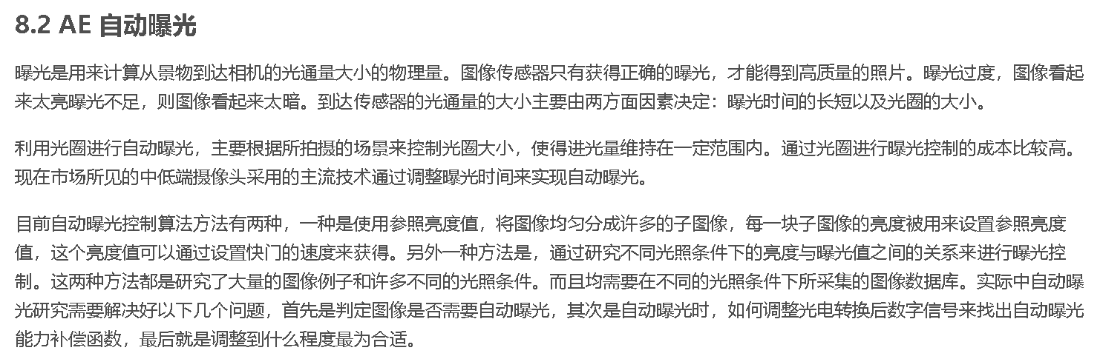
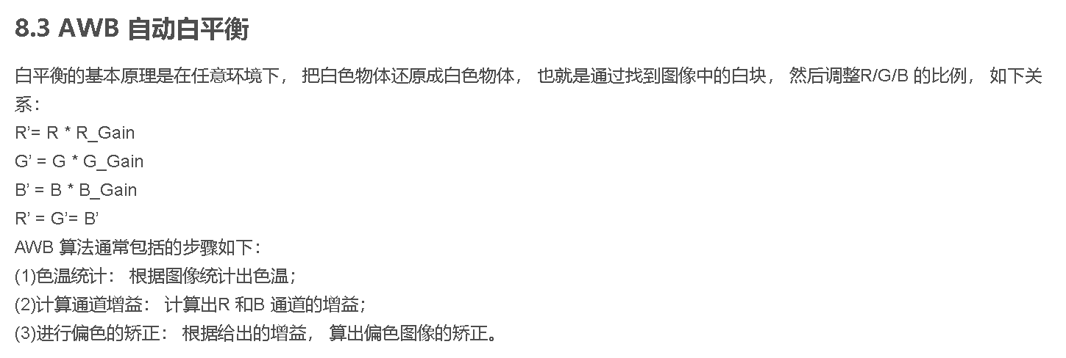
Improve the image from it’s principle
Traditional focusing method & 3A Algorithm
传统的方式中，自动聚焦通过红外线或者超生波测距的方式来实现。这种方式需要安装发射机和接收机，增加了摄像机的成本，而且超声波对于玻璃后面的被摄物体不能很好的自动聚焦。这一类聚焦方式在某些场合受到了限制。因此在日趋集成化、微型化、低成本的应用中，基于数字图像处理的自动聚焦方法更具有优势。
AF ：auto focus
AE ：auto exposure
AWB ：automatic white balance

Slide 8
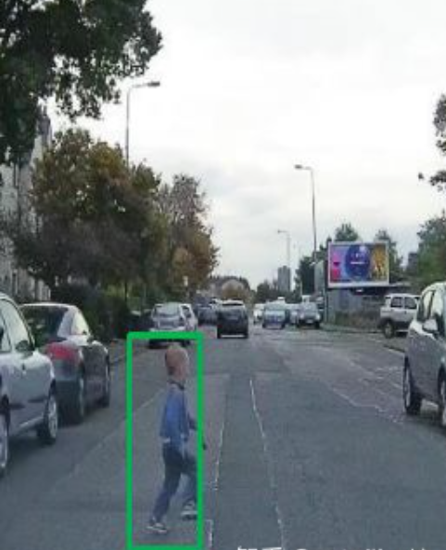
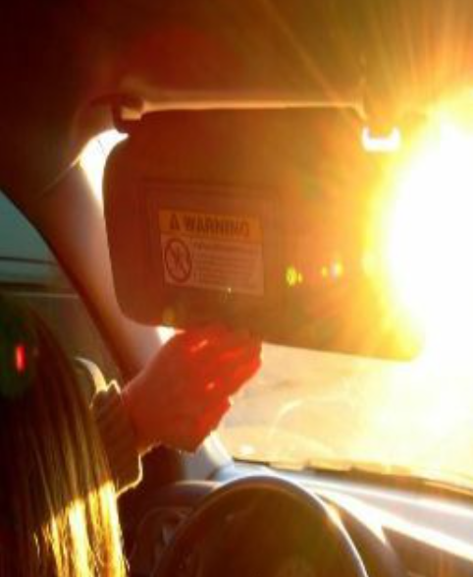
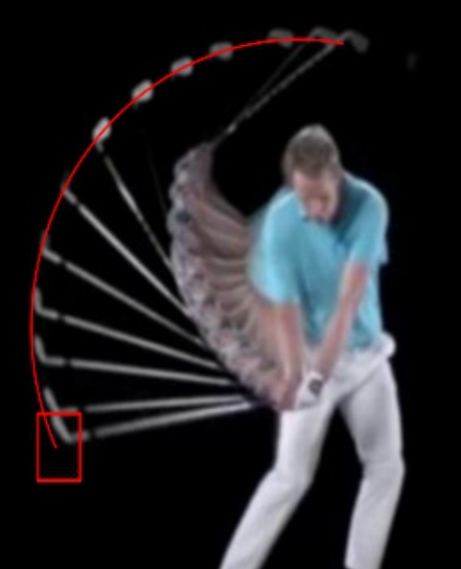
What’s the Event-based camera(EB)/Dynamic Vision Sensor(DVB) ?
traditional camera’s shortage:
帧率
传统相机通过在传感器上积累一定数量的光子来实现“曝光”效果，但这需要一些时间
延迟
导致检测框滞后于行人
动态响应差
当亮度很高时，信息丢失
图像模糊
高速运动球杆击球不清楚

Slide 9
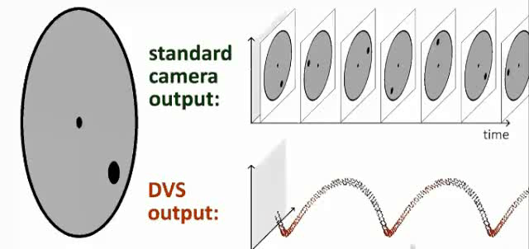
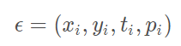
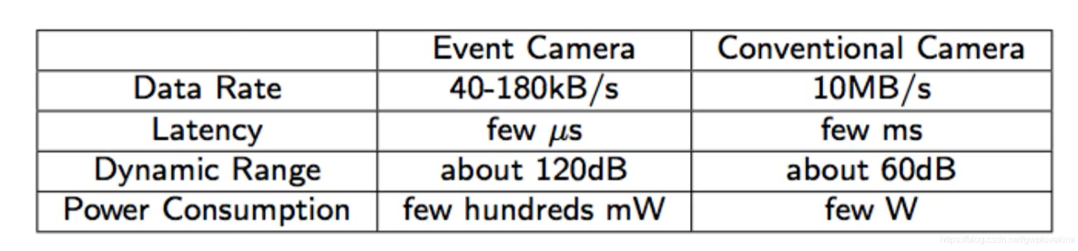
Improve the traditional camera —— EB/DVB!
事件的三个要素:
时间戳,
像素坐标,
极性
强度变化时拍照

Slide 10
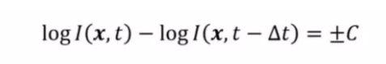
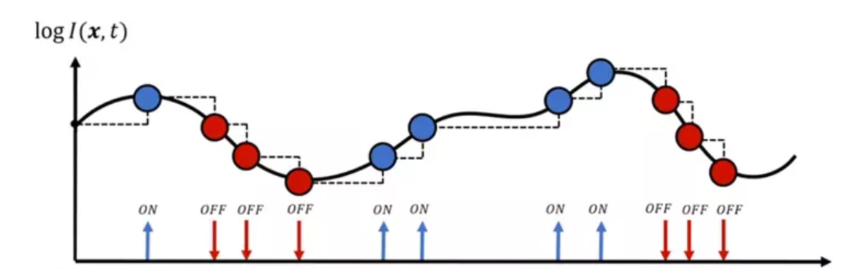
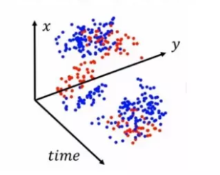
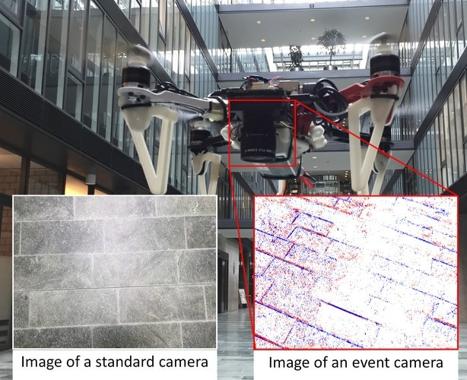
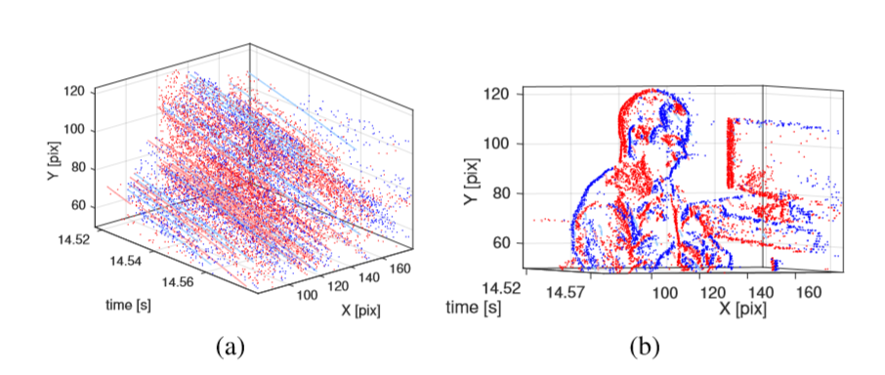
Event Based Camera - Event Stream Image

Slide 11
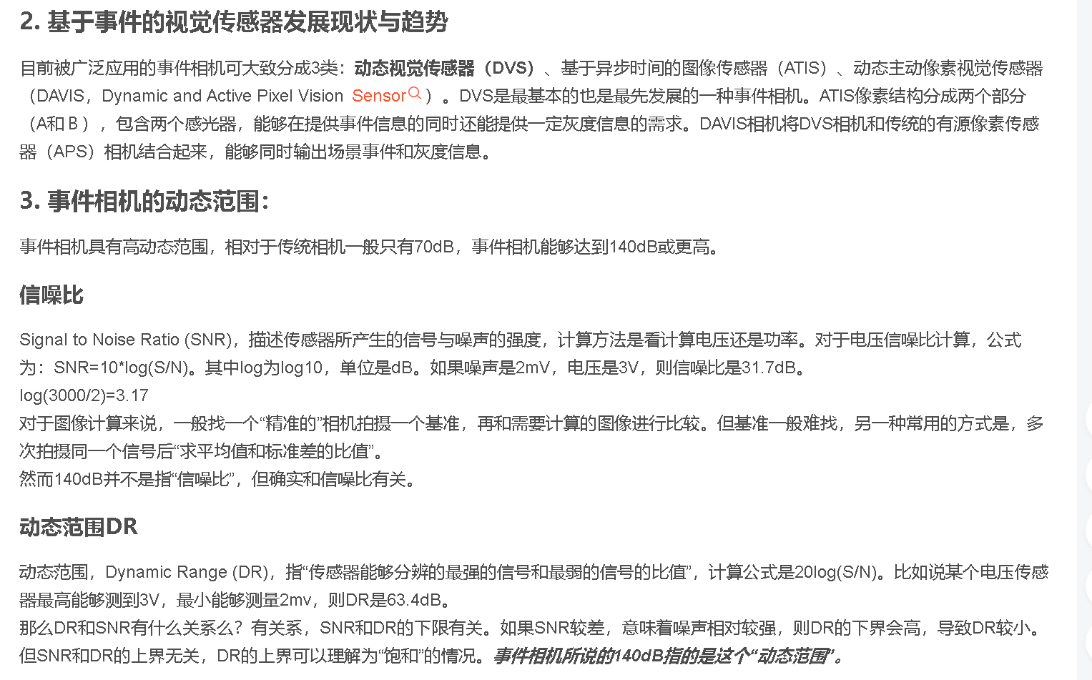
Event Based Camera - Event Stream Image

Slide 12
Application & Aspects of event-based camera
Advantages:
1.低时间延迟，高动态范围，这意味着事件相机可以用于无人机和无人驾驶汽车等智能传感应用
2. 对数据存储和计算资源的需求相对较小
3.在夜间和明亮的灯光下清晰地记录
4. 先进的或当前的传感算法已经成熟，但在处理传统相机拍摄的延迟图像时效果还不够优秀。
Disadvantages:
1. 在绝对静止时无效
2. 太快会引起噪音甚至错误
3.只有轮廓信息，轻信息强信息

Slide 13
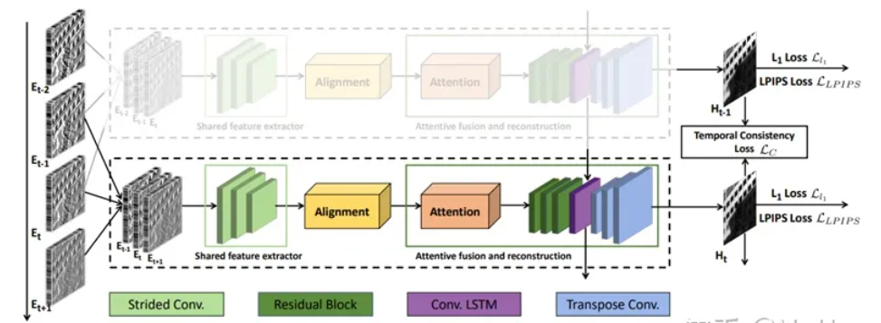
Improve the image from it’s principle
Example 1:
Learning to Reconstruct High Speed and High Dynamic Range Videos from Events (CVPR2021)
1）提出了一种网络架构，能够重建出HDR的video；2）制作了一种采集event的device，能够捕获成pair的HDR-frame和event；3）制作了一个包含HDR-frame的数据集

Slide 14
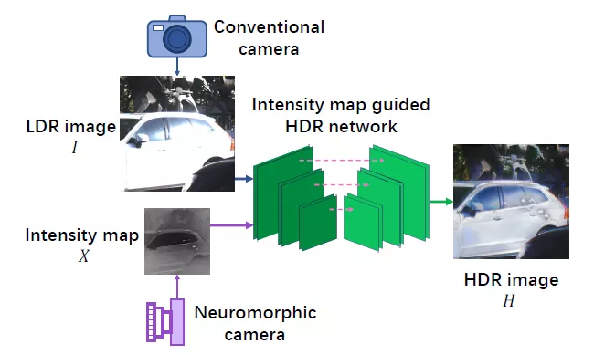
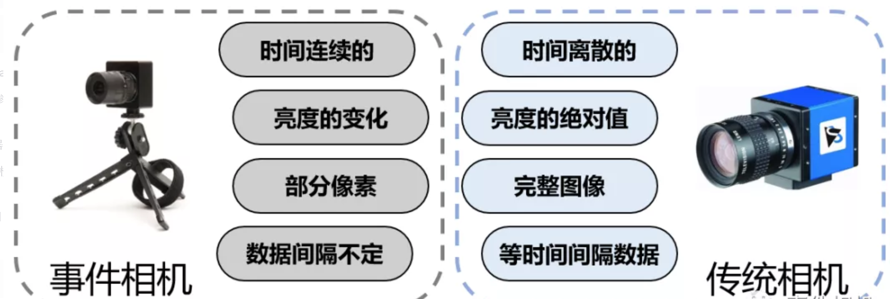
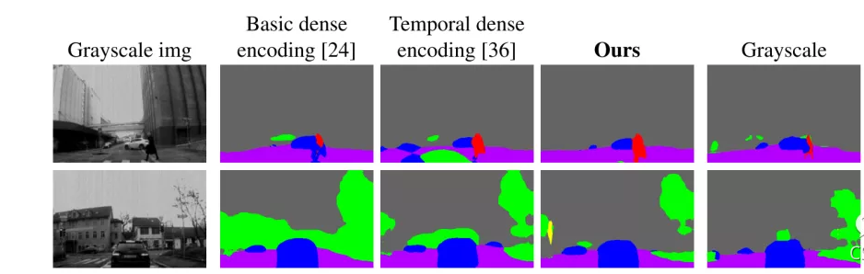
Improve the image from it’s principle
Example 2:
Neuromorphic Camera Guided High DynamicRange Imaging (CVPR2020)
Ev-segnet:Semantic segmentation for event-based cameras （CVPR2019）
为解决传统相机拍摄图像动态范围低的问题，文章[9]采用U-Net结构网络融合了事件相机数据流和传统图像，获得了HDR图像。可以看到，融合后车身反光部分的图像细节得到了补充
文章提出Ev-Segnet，实验表明结合事件相机的数据后，能够对行人、车辆等动态物体实现更精确的分割结果。

Slide 15
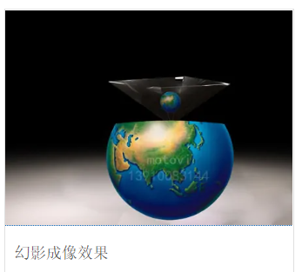
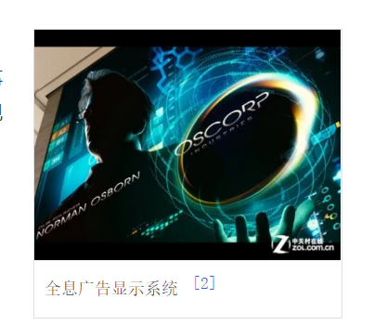
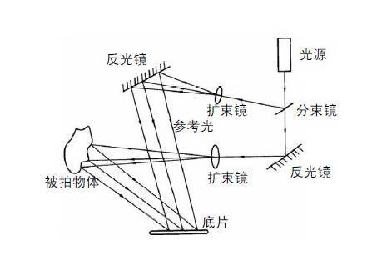
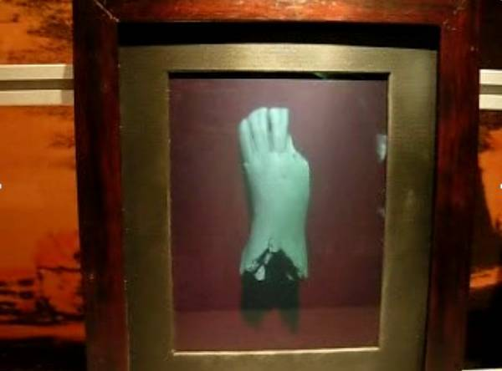
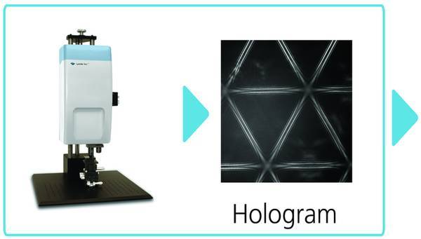
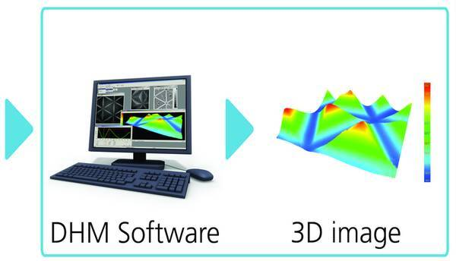
Difference between Optical holography & Digital holography
3D display technology
(spectra vision)
Optical holography
Digital holography

Slide 16
Breif introduction of Holographic Camera
全息技术具有以下突出的特点和优点:
（1）立体感强。因为光线所涉及的物体表面的信息，不仅光的强度还有光的相位都记录在全息图中，所以再现的物体表面的信息表现的很详细。
（2）可再现物体的立体图像。如果物光从多个角度照射，多次拍摄的全息图都集中在一个全息图中，那么用参考光从不同角度照射这个全息图，就可以互不干扰地分别显示出来每次拍摄的图像，从而能够再现物体的3维图像。
（3）全息照片的碎片仍旧能反映出整个物体的图像。 因为全息图像的部分都含有整体干涉的表现，所以，小部分全息图就能存储和再现整个物体的图像。
（4）信息容量大。用全息图存储信息，远大于磁盘和光盘的存储容量大。
全息技术的缺点是，拍摄环境要求高，拍摄成本高。

Slide 17
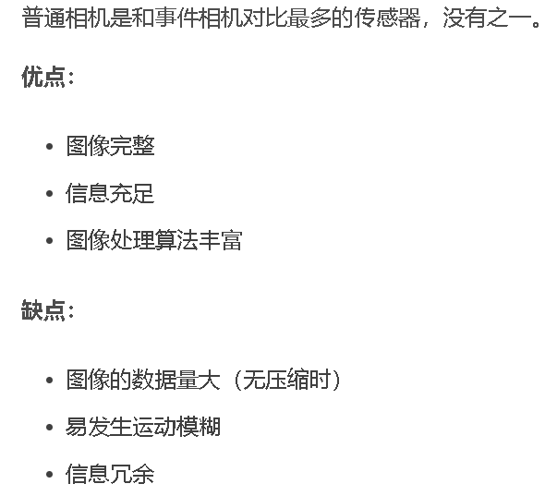
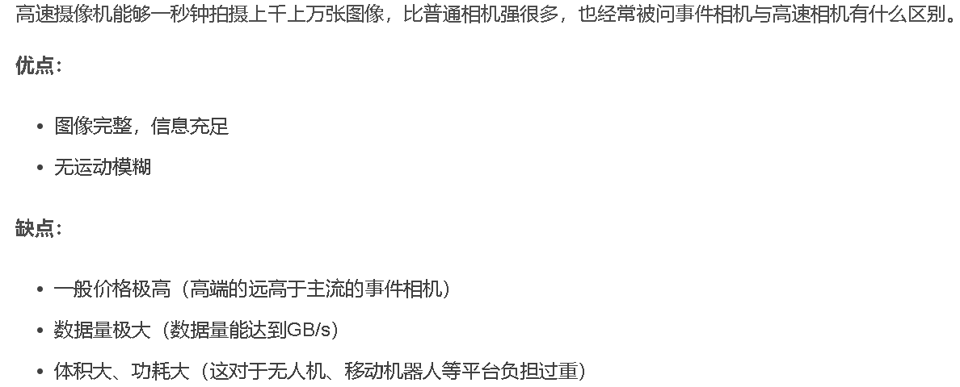
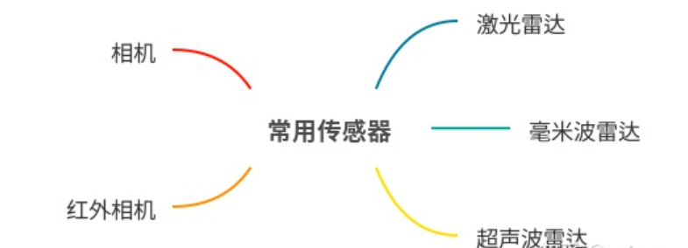
Other cameras
1）激光雷达的测距精度、测距范围及对温度和光照的适应性都很厉害，缺点就是太贵；
2）相机对环境细节信息的提取能力吊炸天，但是光照影响太大，晚上就瞎了；
3）毫米波最大优点探测角度比较大，抗干扰性强，性能比较稳定，另外也不贵，缺点就是分辨率和精度跟不上。
4）超声波雷达最牛逼的地方是便宜，倒车防撞提醒用的一般是这个，一台车上装十个成本才一百块钱，精度也是最差的，不过低速倒车3m左右足够了。
5）红外优点不是很明显，主要就是晚上比较好用，智驾方案里不算标配，很多传感器方案都没有这个，这里就不过多提了。
事件相机具有低延迟、高动态范围(HDR)、无运动模糊、极低功耗、数据带宽低等优点，缺点（或者可以叫做特性）也很明显：数据异步不易处理、单一事件有效信息少、数据稀疏不完整等。这里不展开介绍。

Slide 18
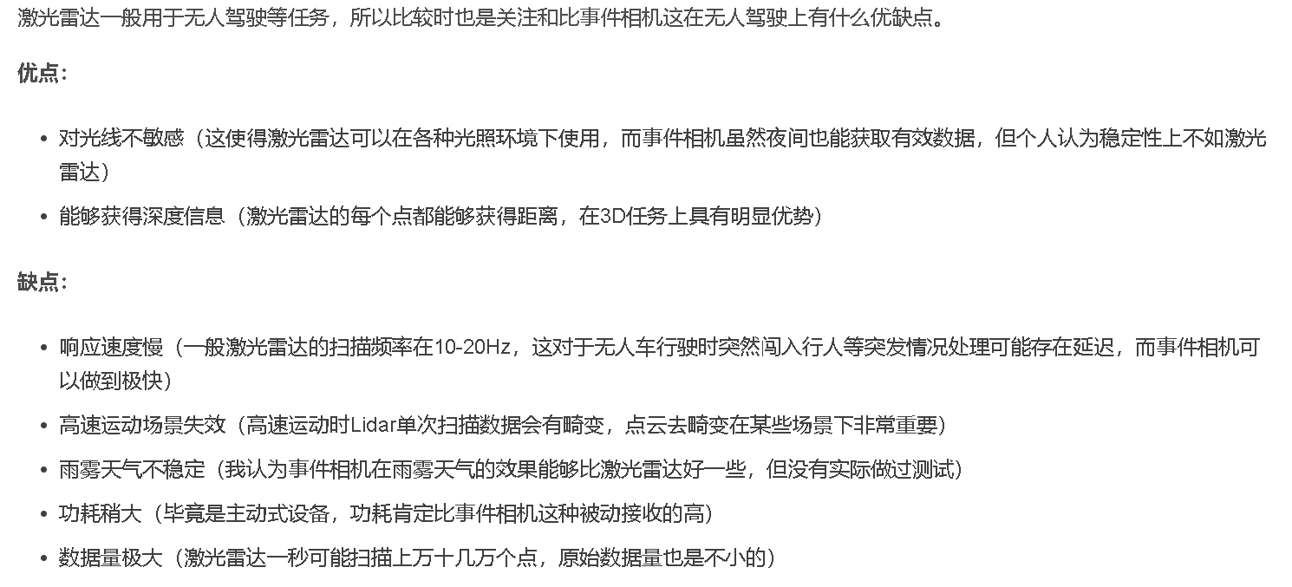
Other cameras

Slide 19
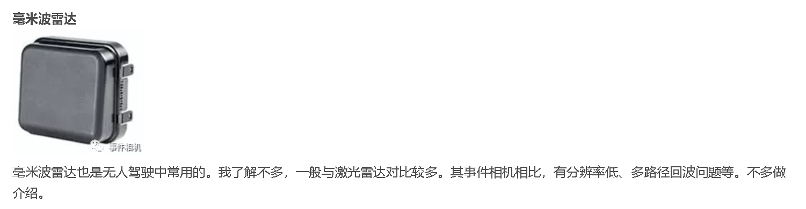
Other cameras

Slide 20
Part 2-1: Camera’s net - Image Preprocessing

Slide 21
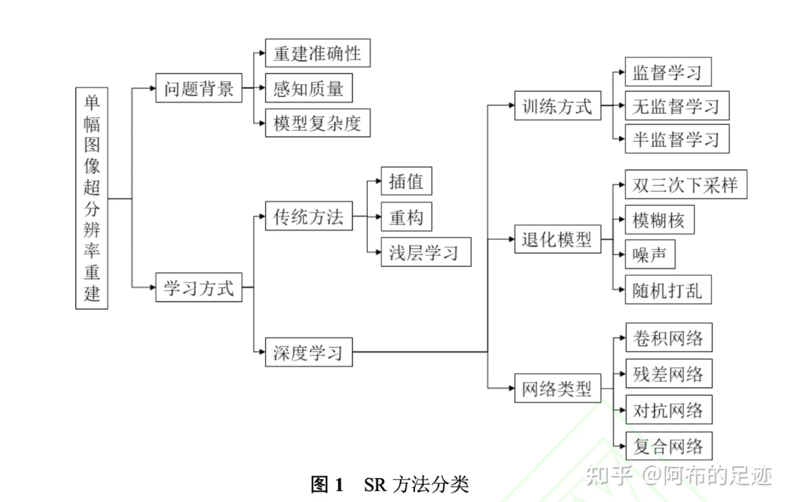
SR(Super Resolution) method
利用有关光学知识从图像中恢复图像细节和其他数据信息的过程。
简单来说，就是提高图像的分辨率，防止图像质量下降。

Slide 22
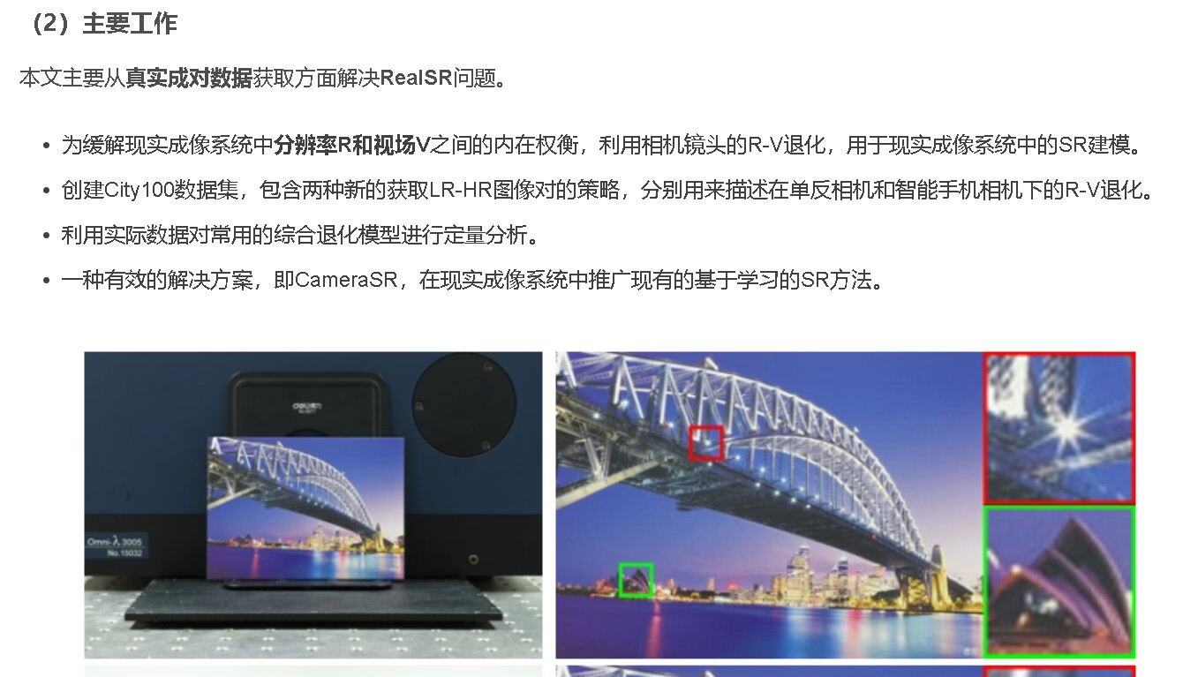
Camera Lens Super-Resolution
# Paper Abstract：
1. Provenance：CVPR 2019
2. Author：
3. Cites：114

Slide 23
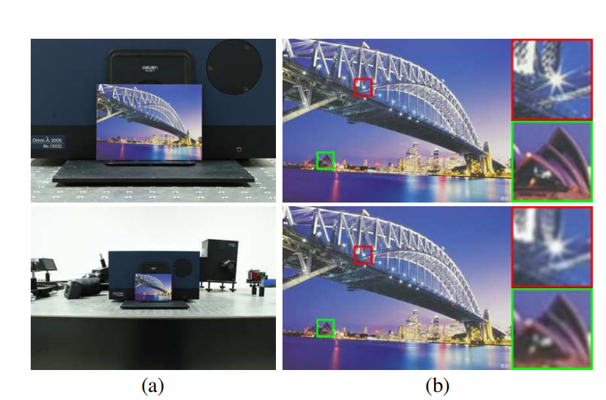
Camera Lens Super-Resolution
True paired data :
Long focal length/short distance : Ground truth
Low focal length/long distance : Pairing object

Slide 24
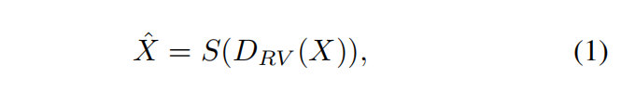
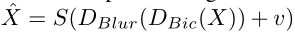
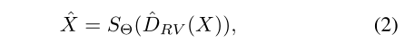



Problem summary

Slide 25

Creating a dataset——City 100

Slide 26



Obvious alignment problems
1. Spatial misalignment
The LR image is shifted by interpolation and the alignment result is obtained
2. Intensity variation
The intensity change is modeled as a deviation in the DC component of the image and estimated by averaging the pixel intensity throughout the image
3. Color mismatching
Color checkerboard was used to calibrate the fitting polynomial parameters

Slide 27



Experiment Outcome

Slide 28

MUTR3D’s advantages & disadvantages
Advantage
Disadvantage
由于其良好的泛化能力，CameraSR作为一种先进的数字变焦工具，在真实成像系统中具有广泛的应用前景
对于LR观测，本文考虑了一个相对理想的无噪声条件。然而，噪声的影响是不可避免的，特别是在智能手机成像系统的小型传感器。

Slide 29


Zoom to Learn, Learn to Zoom
# Paper Abstract：
1. Provenance：CVPR 2019
2. Author：
3. Cites：158

Slide 30

Outcome

Slide 31





Zoom to Learn, Learn to Zoom

Slide 32



Experiment Outcome

Slide 33
Part 2-2 Brief review of EVB（CVPR2021/CVPRW2021）

Slide 34


Slide 35


Slide 36

Advantsges:
1. 使用BMR模块来桥接两种模式，具有良好的特征提取效果。
2. 在此基础上，提出了一种新的图亲和KD算法，提高了KD算法的性能。
3.在两个终端任务上的实验验证了该方法的有效性。
缺点:
1. 只能在与数据集匹配的相应城市使用。
2. 推理延迟是不可避免的。

Slide 37

数字图像在传输的过程中： 往往会受到成像设备和外部环境造成干扰的影响而与本真图像之间产生噪音。只有在数据集中添加了噪音，仿真结果才更具说服力

Slide 38


Slide 39


Slide 40


Slide 41


Slide 42
Part 3:Other Reaserches

Slide 43
Background Knowledge
1. Metasurface
2. DBR
3.PCM

Slide 44








The buzzword “Metasurface” around in academic circles

Slide 45


The buzzword “Metasurface” around in academic circles

Slide 46


The buzzword “Metasurface” around in academic circles
反射，透射，衍射和共振吸收

Slide 47

The buzzword “Metasurface” around in academic circles
例如，右图是用这种材料实现的四分之一波板。
铜超材料受VO2金属丰度的增益和损失的调控。

Slide 48



The buzzword “Metasurface” around in academic circles

Slide 49

Metasurface and optoelectronic devices

Slide 50

Why Metasurface couldn’t be used in camera recently?
色差

Slide 51

PCM——（Phase change materials/memory）
CD
Phase-change memory
0/1
Amorphous
Crystal

Slide 52
Deep neural network enabled active metasurface embedded design
# Paper Abstract：
1. Provenance：Nanophotonics （IF : 7.923）
2. Author：
3. Cites：not very high 35+
Goals:
本文基于深度学习，提出了一种基于有源超表面结构的光子器件正演建模与反演设计方法。

Slide 53




MFP filter conceptual graph
S matrix ：光子从自由态到初态的过渡矩阵S
M matrix：DBR transfer matrix

Slide 54




Forward prediction DNN
The NTN output is as follows:
needle drop for 105 picture

Slide 55


Forward prediction DNN

Slide 56



Inverse design DNN

Slide 57

Design examples with the inverse DNN

Slide 58

Conclusions
优点:
1. 开发一种设计复杂光子结构的方法(DNN有助于改进)
2. 实现计算效率和精确的逆向结构设计
3.该混合设计方案可以推广到其他包含s矩阵描述超表面的光子结构，如波导器件、光子晶体和堆叠多层超表面。

Slide 59
Part 3-2: Semantic Segmentation

Slide 60
U-net :Convolutional Networks for Biomedical
Image Segmentation
# Paper Abstract：
1. Provenance：MICCAI 2015 (MIC+CAI)
2. Author：Olaf Ronneberger, Philipp Fischer& Thomas Brox
3. Cites：10k+ （According to incomplete statistics）
U-net
· Deep learning networks and training strategies are adopted to use annotated samples more effectively according to the way of data enhancement
· The U-NET shows extremely high performance when using the same network trained to project light microscope images

Slide 61


U-net conceptual graph
In the feature extraction part, there is a scale for every pooling layer, including 5 scales of the original image.
For the up-sampling part, every time the up-sampling is performed, the number of channels corresponding to the feature extraction part will be fused at the same scale, but the CROP should be selected before fusion. The fusion here is also splicing.
· RED represents feature extraction
·Yellow represents the upsampling part

Slide 62


Training U-net & Formula
1. The last layer adopts cross entropy function and softmax function
Training method : Stochastic gradient descent
2. Weight chart calculation formula
first set w0 = 10, σ = 5

Slide 63


Examples & Strict requirements for U-net
The red box is the important segmentation area, and the edge of the yellow box indicates that the segmentation result is not affected by cutting into small batches

Slide 64


Improvement of U-net’s images
1. Using “elastic deformation”
2. Edge distortion
3. Before training, each piece is enlarged by mirror image to retain more edge information

Slide 65


Outcome of U-net experiment
win the contset for it’s low warping error(扭曲误差)
ISBI tracking challenge——it’s excellent segmentation

Slide 66
U-net’s advantages & disadvantages
Advantages
1. The edge features are well preserved by the image edge processing
2. The structure of the network is simple and easy to improve
3. The network structure is shallow and information is not easily lost
4. Update of ”w“ is really imaginative & effective
Disadvantages
1. The effect of UNet may be unsatisfactory in many situations

Slide 67
2. Y -Net: a one-to-two deep learning framework
for digital holographic reconstruction
# Paper Abstract：
1. Provenance：Optics Letters 2019
2. Author：KAIQIANG WANG, JIAZHEN DOU, QIAN KEMAO, JIANGLEI DI,AND JIANLIN ZHAO
3. Cites：65+ （According to incomplete statistics）
Problem solved : It can solve end-to-end image processing tasks better than U-NET can solve situations that serve more purposes
Model Abstract : One to two deep learning model

Slide 68
Background Knowledge
1. What is a hologram——intensity and phase
2. Adam optimizer summarize

Slide 69



What is a hologram——intensity and phase
Definition of holography
A hologram is a picture of a subject recorded on a high resolution holographic film by a holographic camera with laser as the light source. With the same laser irradiation, can form before and after two virtual and real stereo scene.
Compared to traditional photographs, holograms contain information about the size, shape, brightness and contrast of the object being recorded.
Complex amplitude（复振幅）:
Complex amplitude expression of object light（物光的复振幅表达式）:
Complex amplitude expression of reference light（参考光的复振幅表达式）:

Slide 70





What is a hologram——intensity and phase
Conjugate(共轭) expression of object light and reference light:

Slide 71




Adam optimizer summarize
1. Stochastic Gradient Descend
2. Momentum
β = 0.9,V=0
3. Adagrad(自适应)
α = 0.01
ε = 10⁻⁷

Slide 72


Adam optimizer summarize
4. RMSprop(均方根传递)
S = 0
α = 0.001
β = 0.9
ε = 10⁻⁶
α = 0.001
β₁ = 0.9
β₂ = 0.999
ε = 10⁻⁸
5. Adam(适应性矩估计)

Slide 73

Y-net conceptual graph
BN+RELU

Slide 74


Training Y-net & Formula
Mean square error（MSE） is used in training
The Adam optimizer with a learning rate starting from 0.001 and halved after every 10 epochs and the mini-batch size of 64 are adopted to update the network’s parameter.
To avoid over-fitting of the neural network, the training stops when the network performance on the validation dataset begins to decline.
N：mini-batch size
where the weight λ of 0.01 gives a good performance
the phase is more highlighted than the intensity in training the network！

Slide 75



Training Y-net & Formula
To quantitatively evaluate the recovery accuracy of the networks, the following structural similarity (SSIM) index
c1 and c2 are regularization parameters with L = 255 (the range of pixel values), k1 = 0.01, and k2 = 0.03

Slide 76
Training Y-net & Formula
The dataset is recorded by a typical digital holographic microscope with a 50× objectivlens. The specimens are mouse phagocytes maintained in a humidified incubator at 37°C and 5% CO2 in Dulbecco’s modified eagle medium (DMEM) supplemented with 10% heat-inactivated fetal bovine serum and 1% penicillin-streptomycin mixture. After attaching to the bottom of a culture dish, 1664 holograms are recorded by the digital holographic microscope. Then the intensity and phase maps of these cells are reconstructed by the convolution method used as ground truth. All the data we have are partitioned into 80% for training, 10% for validation, and 10% for testing.

Slide 77



Outcome of Y-net experiment

Slide 78
Compare with U-net
1. Since the Y-Net saves a down-sampling path and a bridge path, it has 16,029,468 (16M) parameters, compared with 22,790,520 (23M) parameters in U-Net 2, leading to a reduction of 30%, which means that the Y-Net not only combines the functions of intensity and phase reconstruction, but also consumes less time in network training and holographic reconstruction, compared with using two typical U-Nets separately.
2. To summarize, in this Letter, we propose a unique one-to-two Y-Net specially designed for simultaneous reconstruction of intensity and phase information from a single digital hologram. This new method achieves excellent reconstruction results, with SSIM of over 0.96 for intensity and over 0.91 for phase, which defeats other network variants such as a typical U-Net with two output channels (U-Net 1), two typical U-Nets for intensity and phase reconstruction, respectively(U-Net 2), and a Y-Net without single or triple 3 × 3 convolutions (Y-Net 1).

Slide 79
3. Y4-Net: a deep learning solution to one-shot
dual-wavelength digital holographic reconstruction
# Paper Abstract：
1. Provenance：Optics Letters 2020
2. Author：KAIQIANG WANG, JIAZHEN DOU, QIAN KEMAO, JIANGLEI DI,AND JIANLIN ZHAO
3. Cites：23+ （According to incomplete statistics）
Idea :
In this paper, a deep learning solution (Y4-NET, four-output channel network) for one-time dual-wavelength digital holography is proposed to solve the spectral overlap problem.
Model Abstract : One to two deep learning model

Slide 80

Y4 - net conceptual graph
Problems:
1. It is proposed that the existing ways of generating digital hologram images are susceptible to environmental disturbance
2. The existing solution, the "DH method", is not easy to separate different wavelengths of light

Slide 81


Training Y4-net & Formula

Slide 82


Outcome of Y4-net experiment

Slide 83
Y4-net’s advantages & disadvantages
Advantages
1. The problem of segmentation after different wavelength superposition is solved
2. Compared to Y-Net and other holograms, the quality of the effect generated is much better
Disadvantages
1. The trained network is valid only in a small area around the parameters of the original optical Settingss

Slide 84
Multiple Object Tracking
1）FP：False Positive
2）FN：False Negative
3）IDS：ID Switch
4）MOTA: Multiple Object Tracking Accuracy
5）IDF1: ID F1 point
6）MT：Mostly Tracked
7）ML：Mostly Lost
8）MOTP：Multiple Object Tracking Precision
9）FPS：Frames Per Second
Research difficulties：
1) Lack of data set and difficulty in labeling;
2) Target detection is not accurate enough;
3) Frequent target occlusion;
4) The number of targets is uncertain;
5) The speed is slow and the real-time performance is not enough;

Slide 85





Multiple Object Tracking
example：
1. Tracking-by-detection
3. Attention mechanism
2. Combination of detection and tracking

Slide 86

MUTR3D: A Multi-camera Tracking Framework via 3D-to-2D Queries
# Paper Abstract：
1. Provenance：CVPR 2022
2. Author：
3. Cites：15
Abstract:
Ensures accurate and consistent 3D tracking for multiple cameras.
An end-to-end multi-camera tracking framework named MUTR3D is proposed to solve the problems of depth estimation, visual occlusion and appearance blur.
In contrast to previous work, MUTR3D does not explicitly rely on spatial and appearance similarity of the target.

Slide 87

Basic Knowledge Learnig & Works

